Slide 1
Landscape Irrigation
Urban Water Education Series

Slide 2
Training Series
Course I – Introduction to Landscape Watering Principles, Regulations, and Irrigation Systems
Course II – Adjustments, Repair, and Troubleshooting Irrigation Systems
Course III – Design, Auditing, and Advanced Technology in Irrigation

Slide 3
Course I – Objectives
Understand the key principles of landscape watering
Know the laws and regulations pertaining to landscape irrigation and watering
Differentiate methods of landscape irrigation and identify system components

Slide 4
By the end of the training you will:
Be familiar with the Georgia Water Stewardship act and where to find it.
Understand the relationship between water management and disease management
Know the 4 principles of watering
Identify common methods of irrigation
Identify all tools in your training kit
Identify all irrigation components the training kit
Assemble a simple irrigation system with the kit
Use portions of this presentation in your trainings

Slide 5
Industry Scope

Slide 6
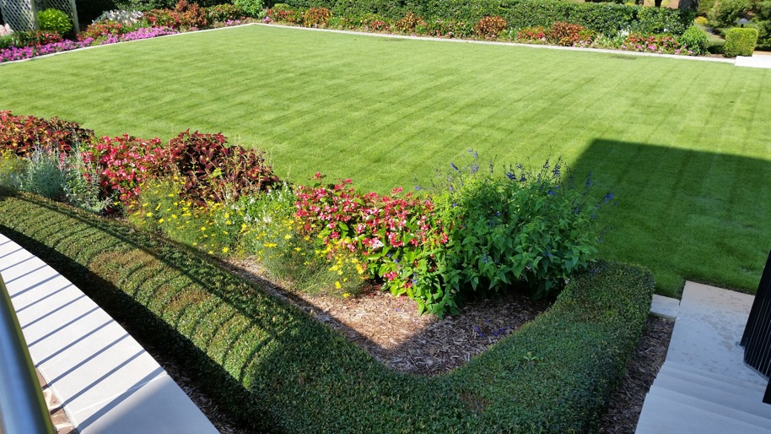
Irrigation and Water Management:
A Universal Skill in Plant Care
Golf Course Managers
Sports Field Managers
Landscape Installers
Landscape Managers
Groundskeepers
Garden Curators
Growers
Retailers/Garden Centers
Food Production
Interiorscapes
Photos by: Rolando Orellana

Slide 7
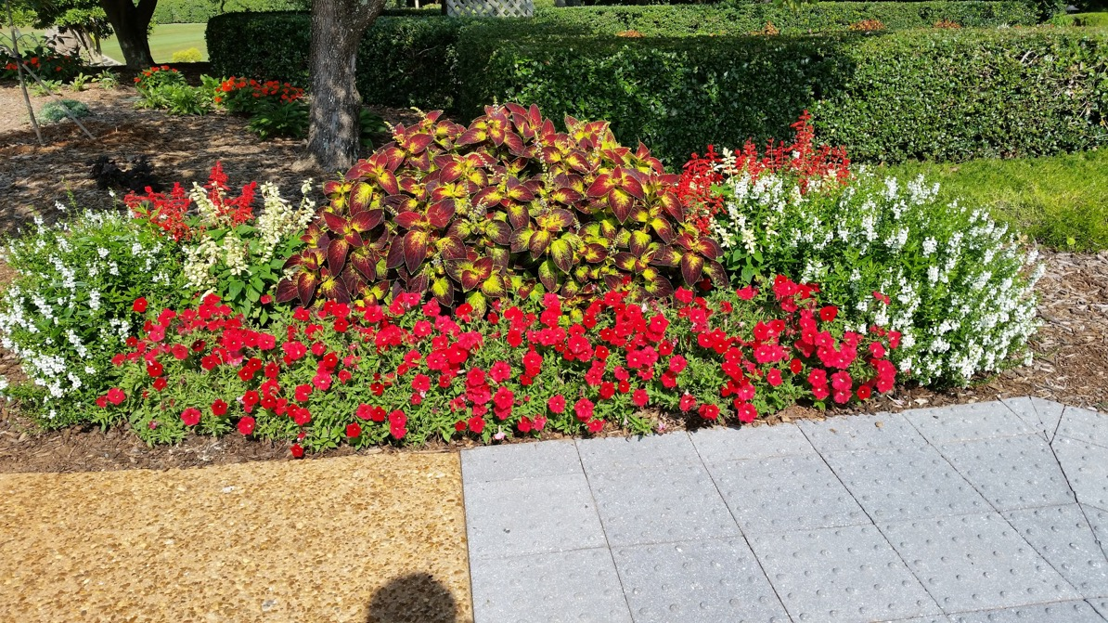
Residential and Commercial Landscapes
Photos by: Rolando Orellana

Slide 8
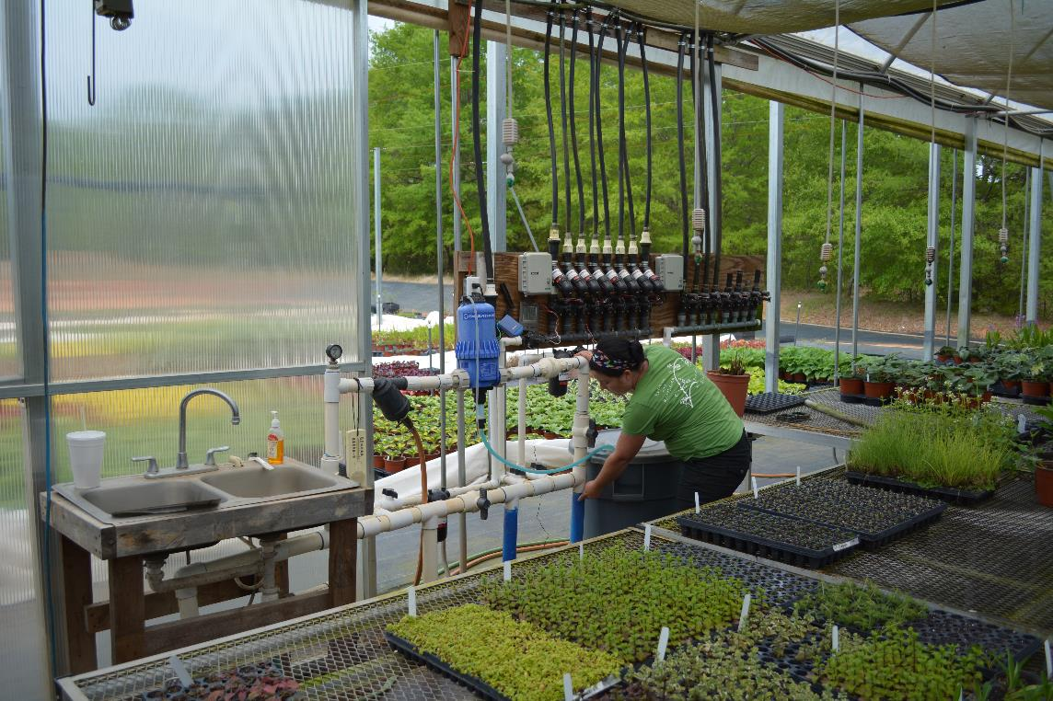
Nursery Operations
Photo by: G. Huber, UGA

Slide 9
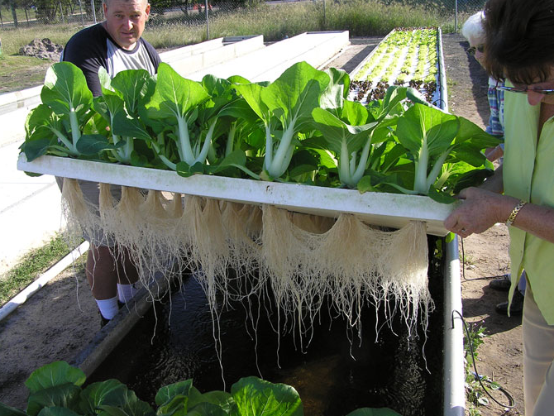
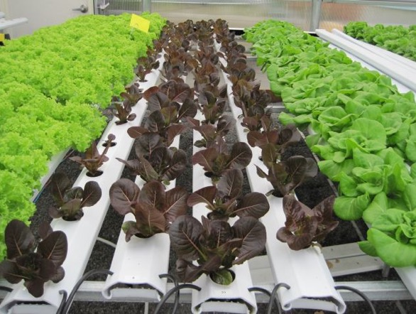
Food Production
Hydroponics Gutter System
Hydroponics/Aquaponics Raft System

Slide 10
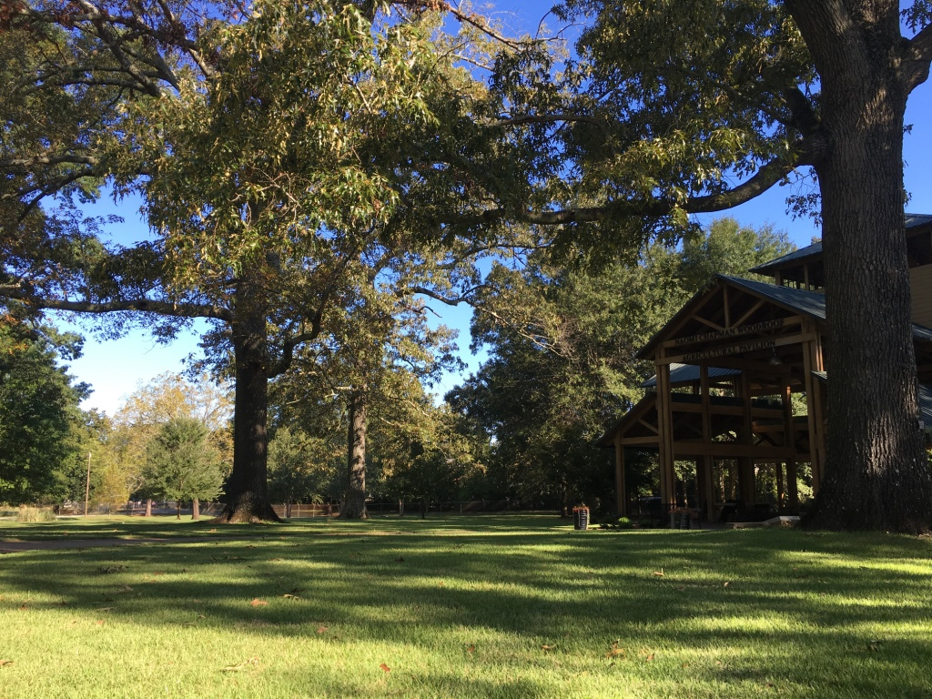
Parks and Recreation

Slide 11
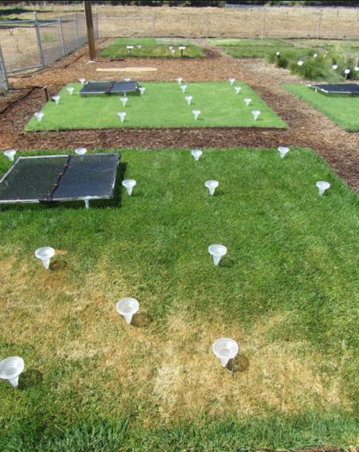
Irrigation Industry
Irrigation Design
Irrigation Installation
Irrigation Maintenance & Repair
Irrigation Auditing and Efficiency Upgrades, and Water Conservation
Irrigation Supplier
Irrigation Research and Development

Slide 12
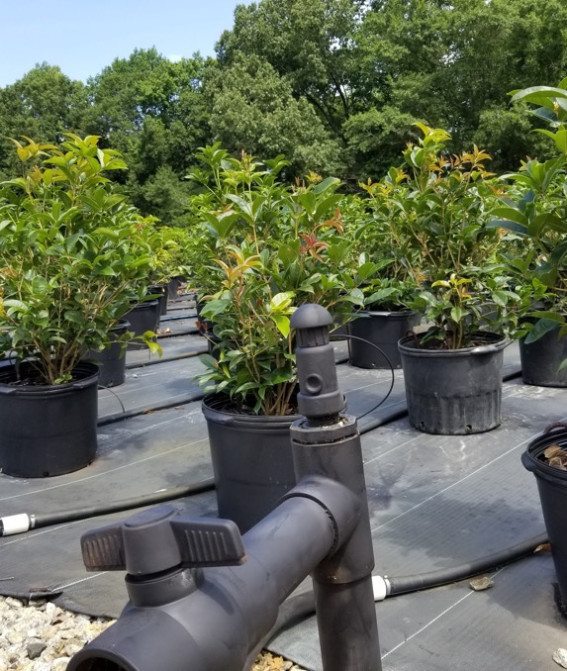
How Does Water Affect Plant Growth?
What does water do for a plant? There are three potential situations with water: too much, too little and, of course, just enough.
Notes:
A lot of the issues addressed by agents are water related.

Slide 13
Watering and Plant Health

Slide 14
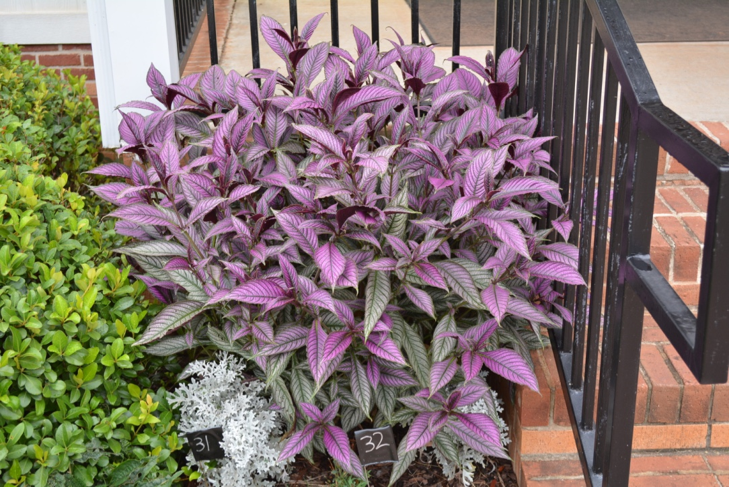
How do plants use water?
Photosynthesis:
Water and Carbon Dioxide are combined to form carbohydrates.
Transpiration:
Water evaporates from the leaf stomata, helping to draw water up from the root system for photosynthesis and cooling.
Note the turgid condition of this Persian shield following a late night water soaking.

Slide 15
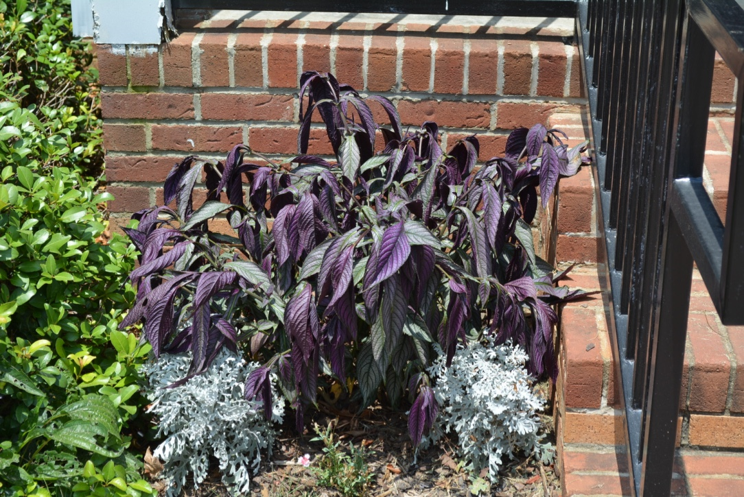


What’s wrong with this plant?
Lack of Water
Heat Stress
Excess Water
Root Disease

Slide 16
What’s wrong with this plant?
Heat Stress
Lack of Water
Excess Water
Root Disease
All of these answers could be correct. However, in a previous slide, it was mentioned that this plant was watered the day before. Heat stress occurs when water is lost at a faster rate than can be absorbed by the root system. This may occur despite plentiful water in the soil. Plants may appear turgid in the morning and wilted by late afternoon, especially in the presence of hot, dry air and, windy conditions.
Drought/Water stress occur when there is not enough water available in the soil.

Slide 17
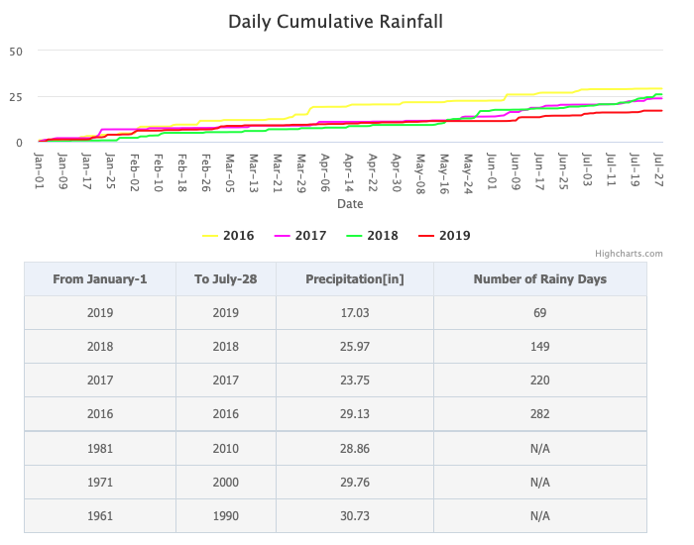

Slide 18
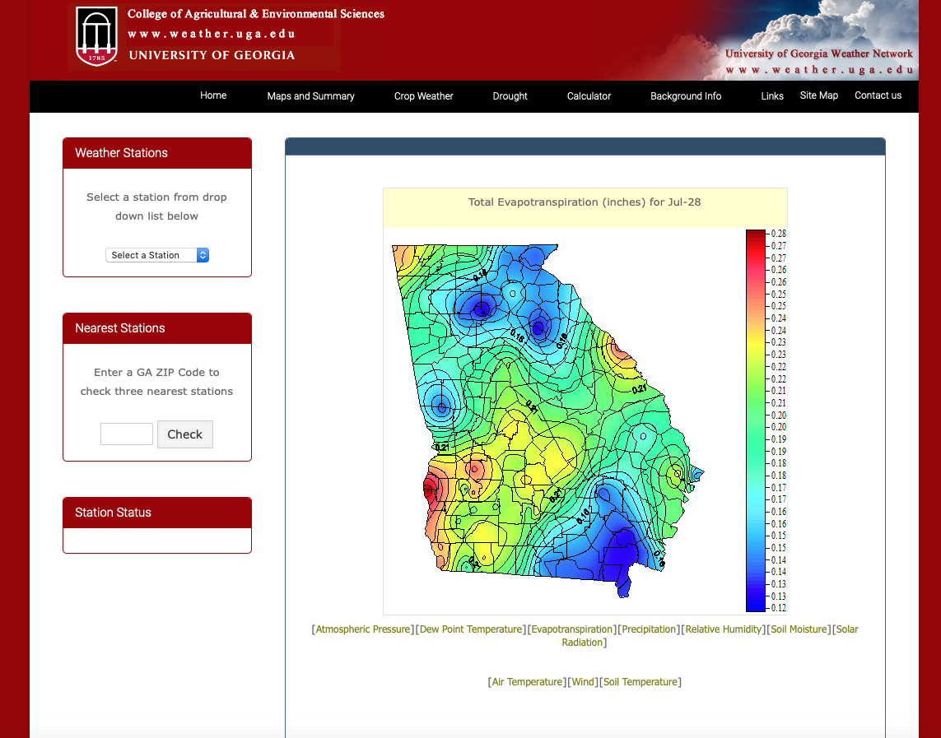
Evapotranspiration (EVT)
<<<Insert diagram showing seasonal EVT>>>

Slide 19
4 Watering Principles

Slide 20
Watering Principles
Principle #1: Supply adequate water to plants without over-watering
Excess Water
Insufficient Water
Displaces Oxygen in the Soil
Hinders Growth
Leaches Nutrients
Increases Disease Potential
Wastes Water
Shallow Roots
Drought/Water Stress
Pest & Disease Pressure
Wilting/Leaf drop
Senescence

Slide 21

Water the Roots! NOT the Foliage
Watering Principles
Principle #2: Water the Roots! NOT the foliage.
Wet foliage favors development of fungal disease
Splashing water spreads fungal spores and bacterial disease
Leaf scorch and sun spots can occur on wet leaf surfaces
Overhead watering is less efficient and requires more water
Foliage may prevent water from reaching the roots where it is needed

Slide 22
Watering Principles
Principle #3: Water Deeply and Infrequently
Deep watering penetrates the soil 4-6”
Deep watering encourages deep root development
Deep root systems are more drought tolerant and efficient
Evaporation is reduced with deep watering
Moisture persists longer 4-6” below the surface
Deep, infrequent watering reduces watering days and conserves water
Deep watering generally requires multiple start cycles and stacked watering intervals to allow water to soak and penetrate

Slide 23
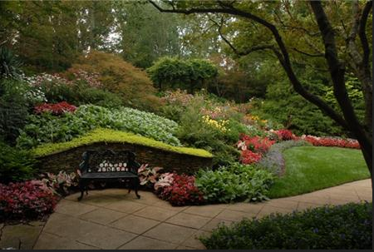
A Single Landscape has Different Watering Requirements
Principle #4: Water according to specific plant needs
A landscape may consist of:
Lawn from Africa
Groundcovers from the Mediterranean
Shrubs from Asia
Flowers from South America
Trees from North America
Landscape plants originate from climates around the world. A good landscape irrigation system is designed to provide the proper amount of water to each plant based on specific needs, not as a “one size fits all” approach.

Slide 24
Watering Needs Vary by Plant Type
Lawn
Flower Beds
Fruits and Vegetables
Groundcovers
Shrubs
Trees
Tip: Eliminate problem areas by designing landscapes and grouping plants with similar watering requirements.

Slide 25
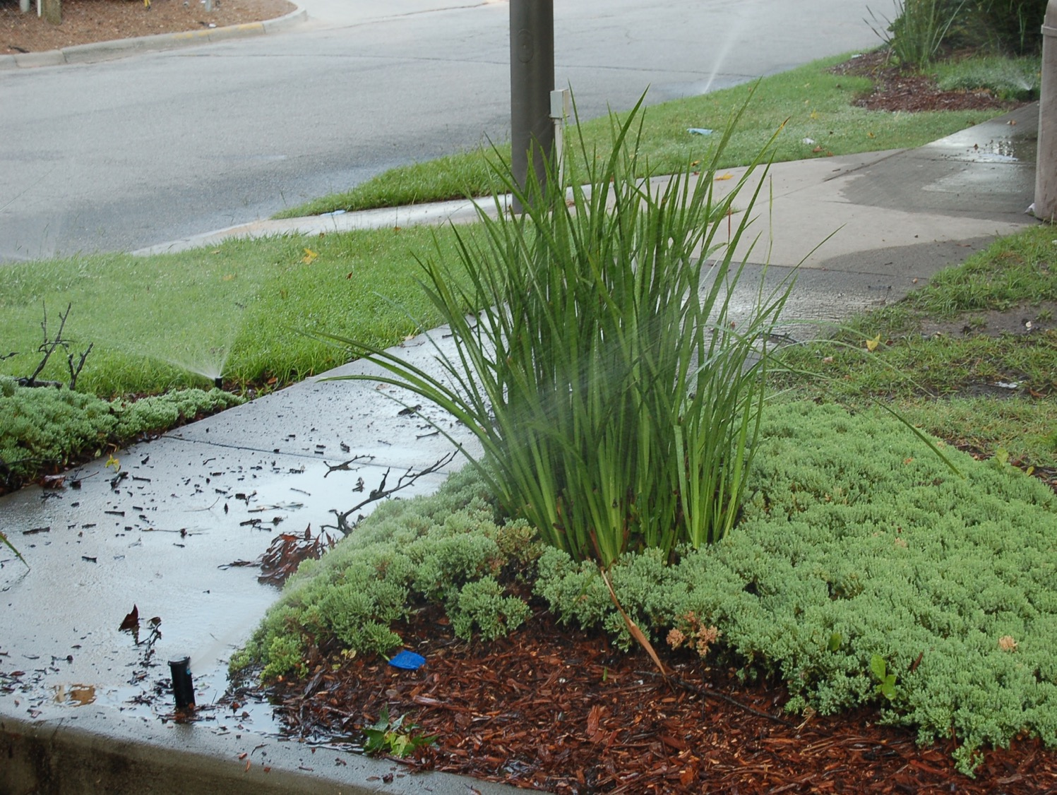
Does this irrigation system respond to the watering requirements of various plant species?
Photo by: David Linvill, UGA

Slide 26
Brief Review of Watering Principles
Principle #1: Supply adequate water to plants without over-watering
Principle #2: Water the Roots! NOT the foliage
Principle #3: Water Deeply and Infrequently
Principle #4: Water according to plant type

Slide 27
Key Points - Watering Principles
Deep infrequent watering is recommended. (as opposed to shallow frequent watering)
Watering should be adjusted according to plant type.
Watering early in the morning conserves water.
Wet foliage increases disease occurrence.
Foliar diseases are spread by splashing water.

Slide 28
Key Points - Watering Principles
Stressed plants are more susceptible to pests and diseases.
Too much or too little water can result in plant stress.
Watering for establishment is different than maintenance watering.
Fluctuations in soil moisture can help to break certain pest and disease cycles.

Slide 29
Key Points - Watering Principles
The symptoms of heat stress and root rot are often mistaken for lack of water. (flagging/wilting)
Too much or too little water can result in plant stress.
Watering for establishment is different than maintenance watering.
Fluctuations in soil moisture helps to break certain pest and disease cycles.

Slide 30
Laws & Regulations

Slide 31
Georgia Water Stewardship Act of 2010
Established a more organized system for managing water resources
Established Outdoor Watering Guidelines
Formalized Drought Management Rules
Developed through the collaborative efforts of industry, researchers, citizens, government

Slide 32
EPD Permitted Water Systems
Public Water Supply Systems
Surface or Groundwater Withdrawals requiring state withdrawal permits (daily withdrawal of over 100,000 gallons per day)

Slide 33
Georgia Water Stewardship Act of 2010
 | Normal Conditions | Outdoor Watering allowed between 4pm and 10am any day of the week
 | Drought Level I | Calls for heightened awareness and conservation campaign
 | Drought Level II | Odd/Even outdoor watering restrictions
 | Drought Level III | Emergency bans on outdoor watering
***Note: Refer to the Georgia Water Stewardship Act for specific information on outdoor watering and exemptions

Slide 34
Ga Water Stewardship Act

Slide 35
GWSA Drought Level 2 - Odd/Even 2-day Outdoor Watering Schedules
Odd Addresses = Thu/Sun 4pm-10am***
Even Addresses = Wed/Sat 4pm-10am***
No outdoor watering on Mon, Tu, Fri***
Consider basing watering schedules on this format regardless of drought level

Slide 36
Key Points – Laws & Regulations
A low voltage electrical license is required to install irrigation in the State of Georgia.
When tapping into a potable water supply for irrigation, a backflow device must be installed by a licensed plumber.
A rain sensor shut-off switch is required by law within the Metropolitan North Georgia Water Planning District. (HB 1277)

Slide 37
Key Points – Laws & Regulations
The Georgia Water Stewardship Act establishes a statewide framework for landscape water use. (GWSA).
There are many exemptions to the GWSA including a 30-day establishment period for new landscapes.
During drought level 2, the GWSA establishes odd-even watering schedules by address number.
The GSWA prohibits outdoor watering between 10am and 4pm.

Slide 38
Irrigation Methods and Components

Slide 39
Irrigation Trivia
Name 4 methods of irrigation/water delivery

Slide 40
Irrigation Trivia
Name 4 methods of irrigation/water delivery.
  Hand Watering
  Overhead Sprinklers
  Micro Irrigation
  Drip Irrigation
  Subsurface Irrigation
  Soaker Hose
  Flood Irrigation - Ebb and Flow
  Water Pots/Drip Reservoirs

Slide 41
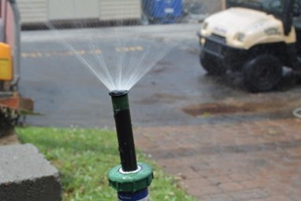
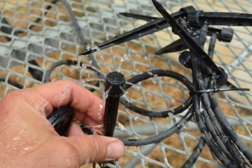
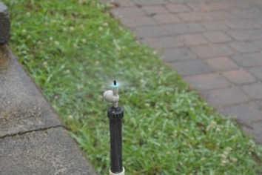
Typical Landscape Irrigation Systems
This Training will focus on Overhead and Drip Systems that are commonly used in the Nursery and Landscape Industry.
Overhead Irrigation (High volume)
  Rotors
  Impact
  Fixed Spray
Drip & Micro Irrigation (Low Volume)
  Drip Emitters
  Micro Spray

Slide 42
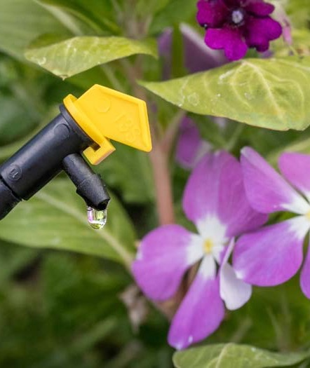
Drip Irrigation
This system is good for a small yard or for watering individual plants.

Slide 43
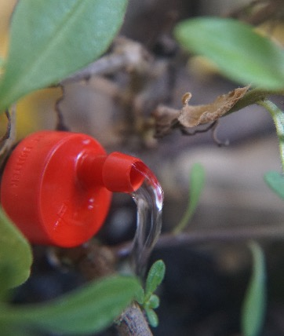
Drip irrigation is highly effective at supplying one to four gallons of water per hour directly to the soil.
The advantage of drip irrigation over sprinklers is that there is little water loss due to evaporation or runoff.
It’s particularly good for mulched areas because it can directly soak the soil without washing away the mulch.

Slide 44
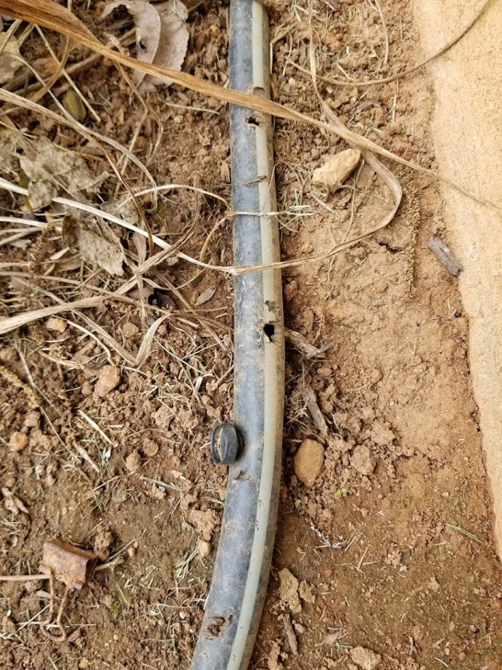
Drip Limitations
Initial costs (for parts and time)
Maintenance required
  Clogging
  Rodent chewing
  Cutting by shovels/implements
Limited coverage of root system
Difficult to see if its working without bending over and close inspection

Slide 45
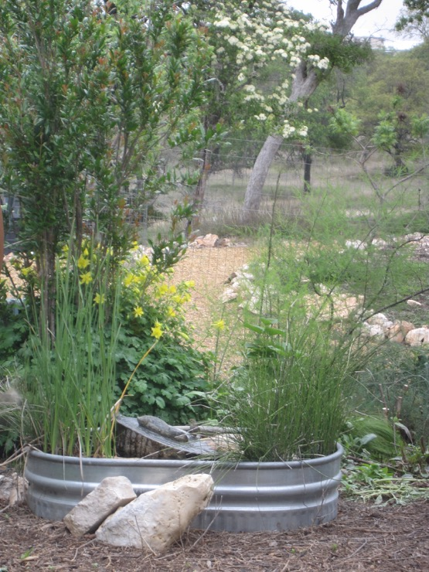
Where is drip useful?
Rose gardens
Perennial garden
Shrub area
Vegetable garden
Ground cover
Orchards
Greenhouse
New trees
Native plants
Non-native plants
Sloped areas
Water features
Etc.

Slide 46
Pros and Cons of Drip Irrigation
PROS
  Efficient, plant specific water distribution
  Root watering vs. wet foliage
  Minimizes evaporation and drift
  Above ground, less trenching
CONS
  Not conducive to lawn areas
  Maintenance – clogs, kinks, critters chewing
  Cumbersome

Slide 47
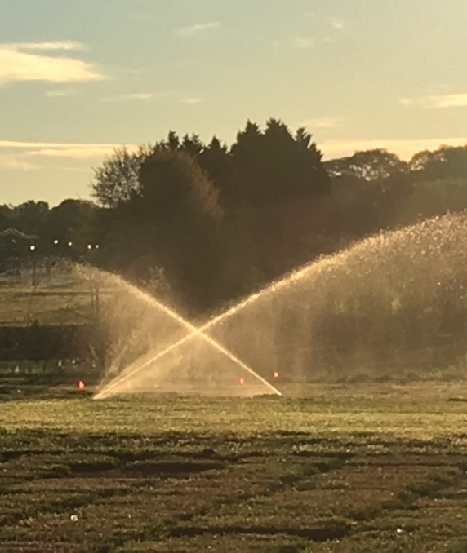
Overhead Irrigation
xxxxxxxx

Slide 48
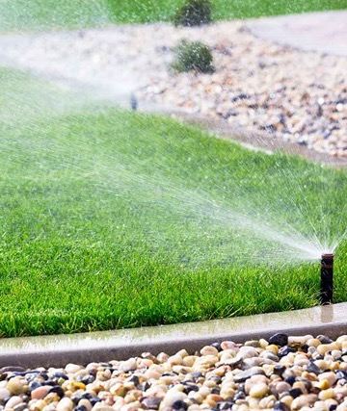
Sprinkler Systems
Sprinklers can cover large areas.
Automatic sprinkler systems offer the benefit of programmable controllers.

Slide 49
Pros and Cons of Overhead Irrigation
PROS
  Large area coverage using minimal equipment
  Even distribution
  Low maintenance
  Excellent for lawn areas
CONS
  Coverage is not plant specific
  Not easily adapted to patchy, irregular shapes with islands, pavements, and obstacles.
  Drift, evaporation, runoff
  Wet foliage, disease potential

Slide 50
Water Source/Point of Connection
Municipal/Public Water Source
Private Well or Body of Water
Rainwater Harvest
Greywater

Slide 51
Sample Connection: Public Water Supply
Public Water Main
Tap Line
Note: Installation of backflow devices typically performed by a licensed plumber according to local code
Shut Off Valve
Water Meter
Shut Off/Isolation Valve
Backflow Prevention Device (Example: RPZ or DCV)
Irrigation Valve(s)
Zone 1
Zone 2
Irrigation Supply Line
Supply Line to Residence
Zone 3

Slide 52
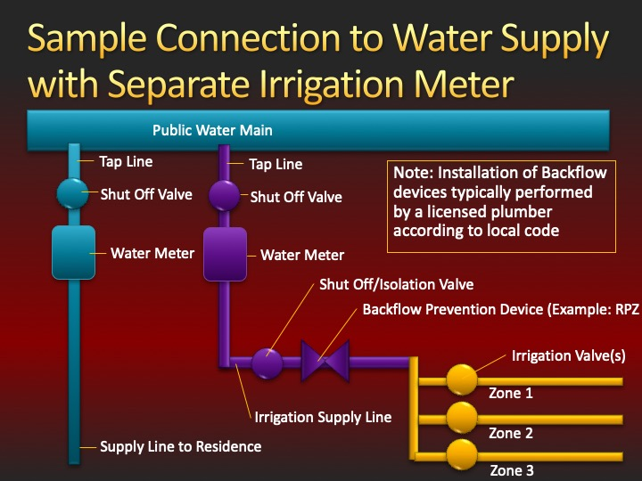

Slide 53
Public Water Source/Point of Connection
Concrete Vault with Municipal Water Main Access
Water Meter
Above Ground Backflow Prevention Device protected by insulated cover
Manual Shut-off/Isolation valve
Point of Connection
Photo by: G. Huber, UGA

Slide 54
“RPZ“– Reverse Pressure Zone
Backflow Preventor
  Ports for Periodic Testing
  Replaces the Traditional DCV, check codes for requirements
  Requires Installation by a licensed plumber
Photo by: G. Huber, UGA

Slide 55
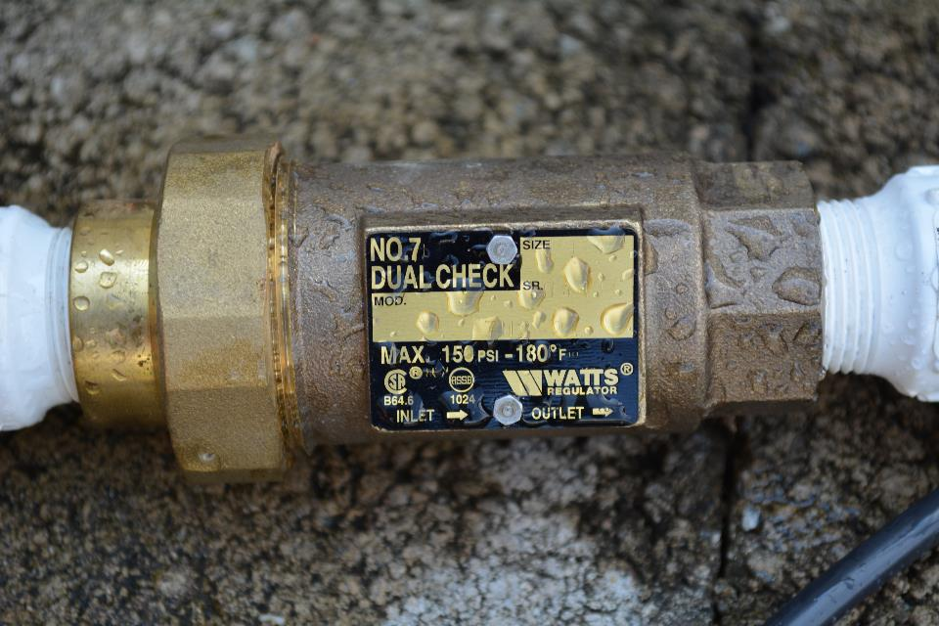
Backflow Preventor
(Dual Check Type)
Photo by: G. Huber, UGA

Slide 56
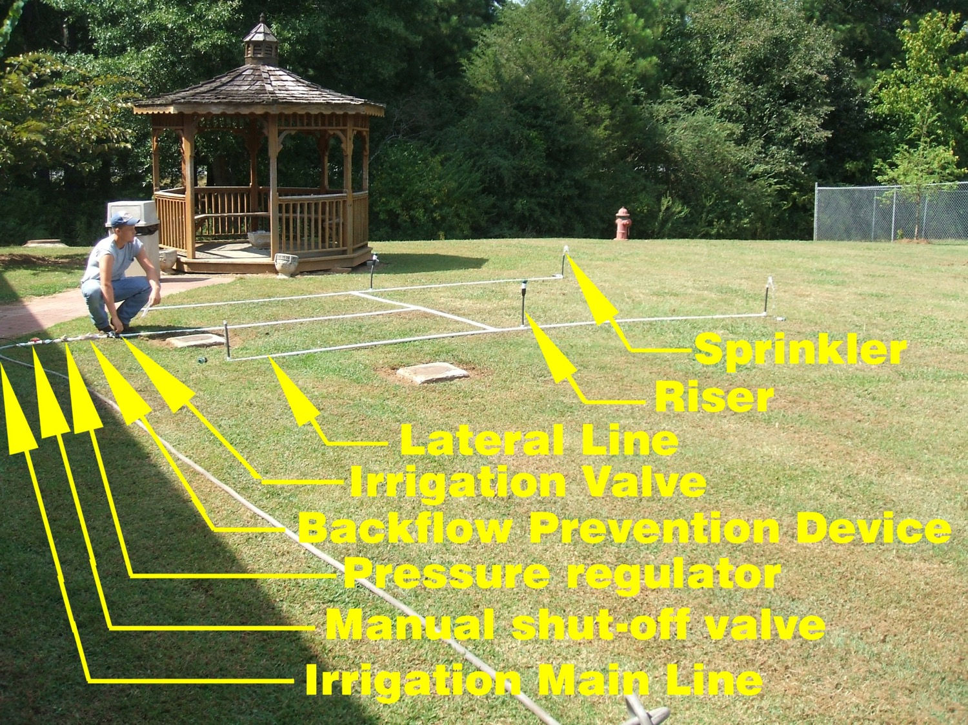
Example of a simple overhead sprinkler system (Prior to trenching and burial)

Slide 57
Piping
PVC (Polyvinyl Chloride)
  Schedule Pipe - example: Sch 40 (traditional dimensions of steel pipe: 40, 80, etc.)
  Pressure Rated – example: Class 160, 200 (PR160, PR200) Pressure rated
PE (Polyethylene)
CPVC - Chlorinated Polyvinyl Chloride

Slide 58
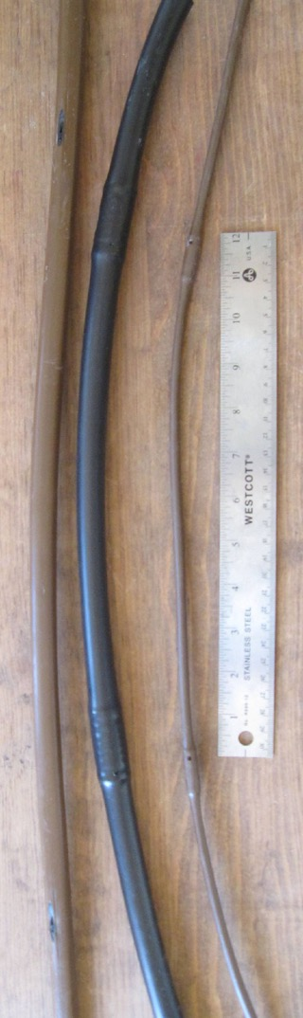
Emitter Tubing
Brown ½” (.63”) emitter tubing with 18” spacing by Rainbird between emitters
Black ½” (.7”) emitter tubing with 12” spacing by Orbit
Brown ¼” emitter tubing with 12” spacing

Slide 59
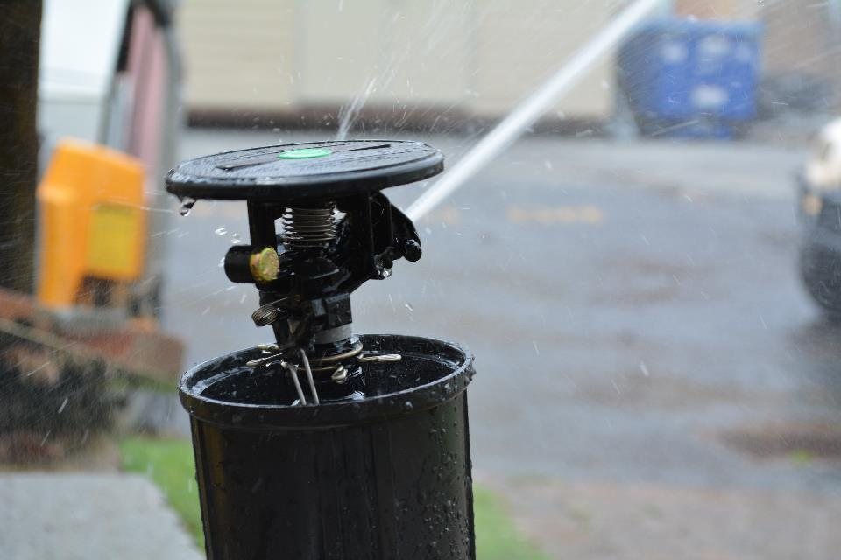
Impact Sprinkler
Photo by: G. Huber, UGA

Slide 60
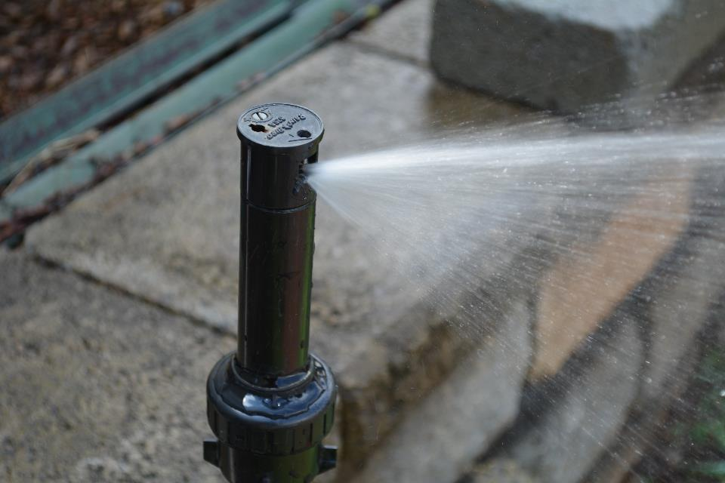
Rotor (Single Stream)
Photo by: G. Huber, UGA

Slide 61
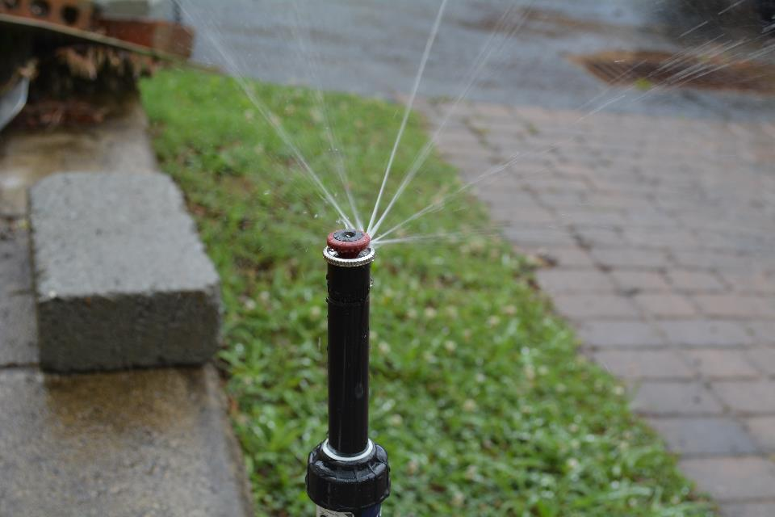
Rotor (Multi-Stream)
Photo by: G. Huber, UGA

Slide 62

Fixed Spray
Photo by: G. Huber, UGA

Slide 63

Micro Spray
Photo by: G. Huber, UGA

Slide 64
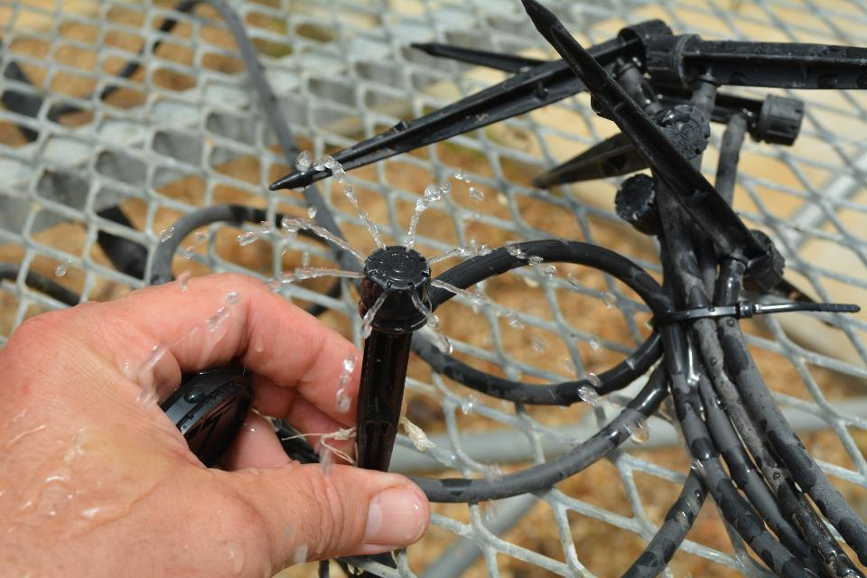
Adjustable Drip Emitter w/Stake
Photo by: G. Huber, UGA

Slide 65
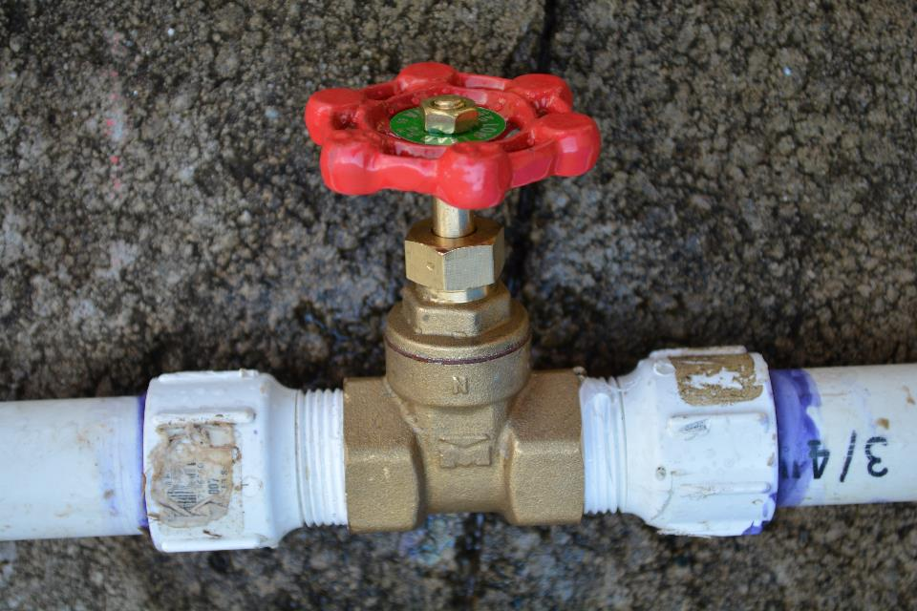
Manual Valve (Gate)
Photo by: G. Huber, UGA

Slide 66
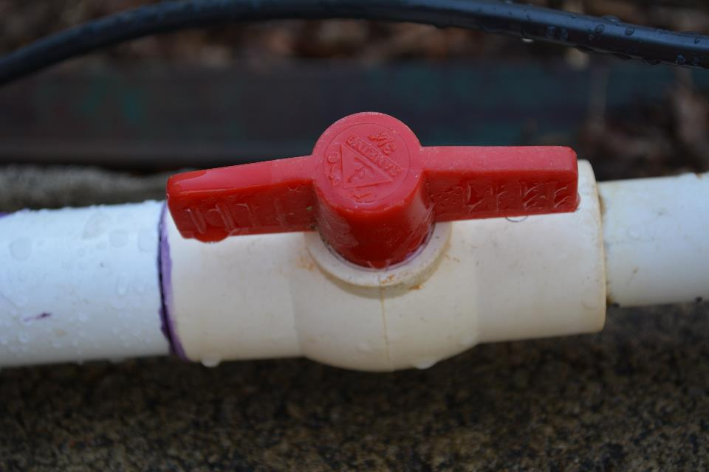
Manual Valve (Globe/Ball)
Photo by: G. Huber, UGA

Slide 67
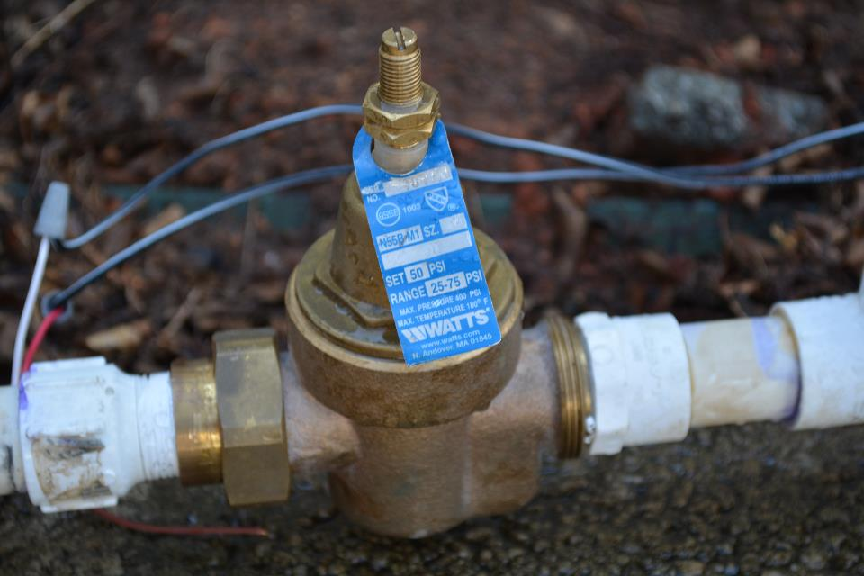
Pressure Regulator (Adjustable)
Photo by: G. Huber, UGA

Slide 68
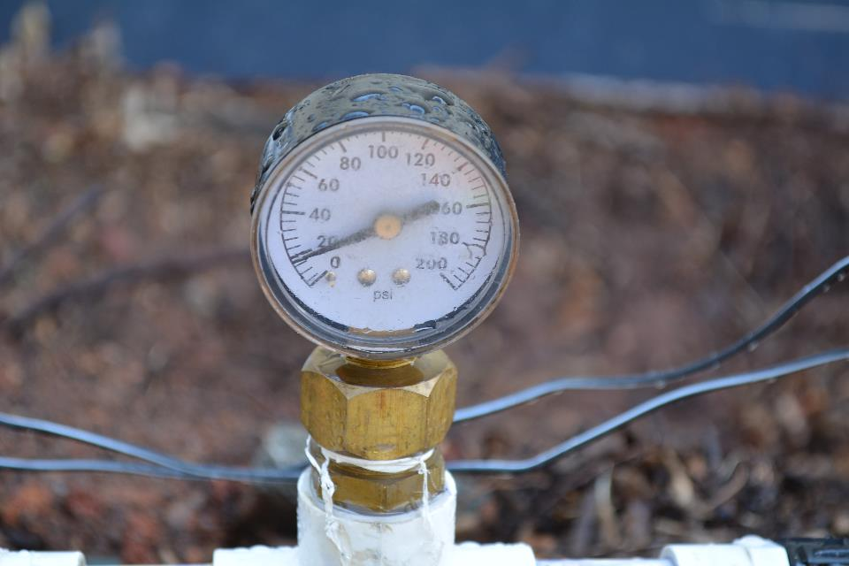
Pressure Gauge
Photo by: G. Huber, UGA

Slide 69
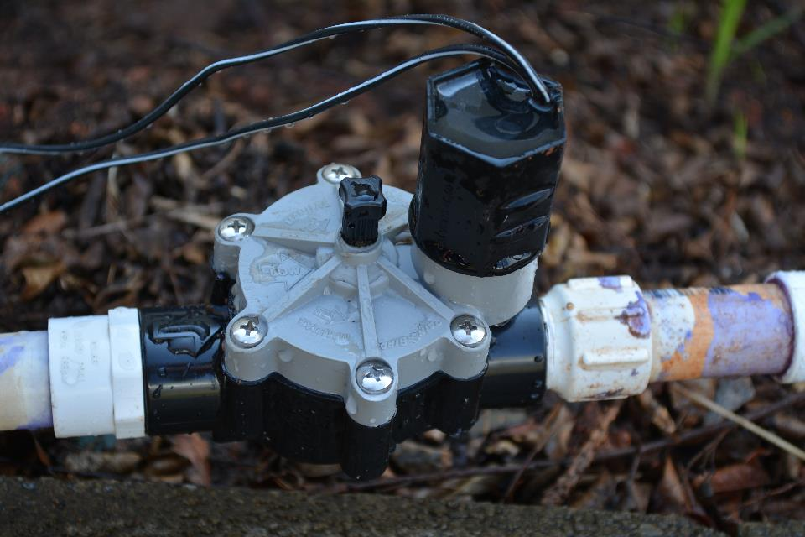
Electric Valve
Photo by: G. Huber, UGA

Slide 70
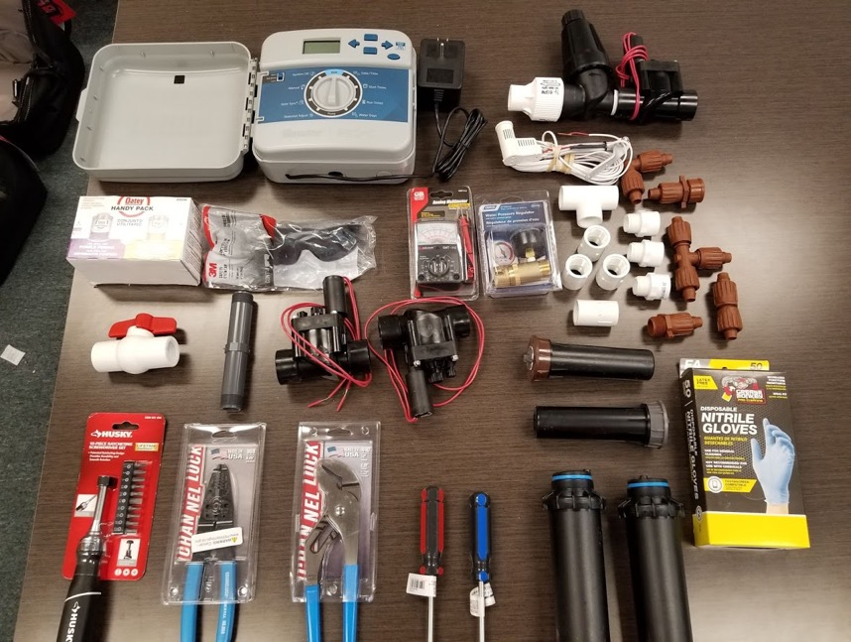
What’s in the Kit?
Controller
Rain Sensor
Electric Valves
Sprinklers/Nozzles
Filter
Regulator
Pipe & Fittings
Control Wire
Nozzles & Emitters
Photos by: Rolando Orellana

Slide 71
Parts Diagram
Drip Tubing
Y Filter/Strainer
Nozzle & Emitter kit
Controller/Timer
Rain Sensor
Sprinklers
Fittings, Risers, Couplings
Electric Valve
Control Wire

Slide 72
Nozzles, Emitters, & Misc. Kit
Photos by: Rolando Orellana

Slide 73
Controller & Rain Sensor

Slide 74
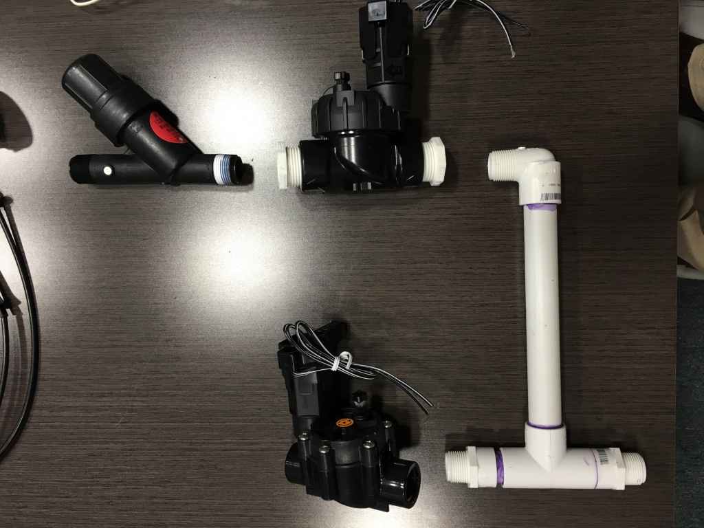
Electric Valve (1)
Filter/Regulator Combo
Valve Manifold Assembly
PVC Manifold Pipe
Electric Valve (2)

Slide 75
Controller Wiring
Transfrmer

Slide 76
Irrigation Plan
Sample Drawing

Slide 77
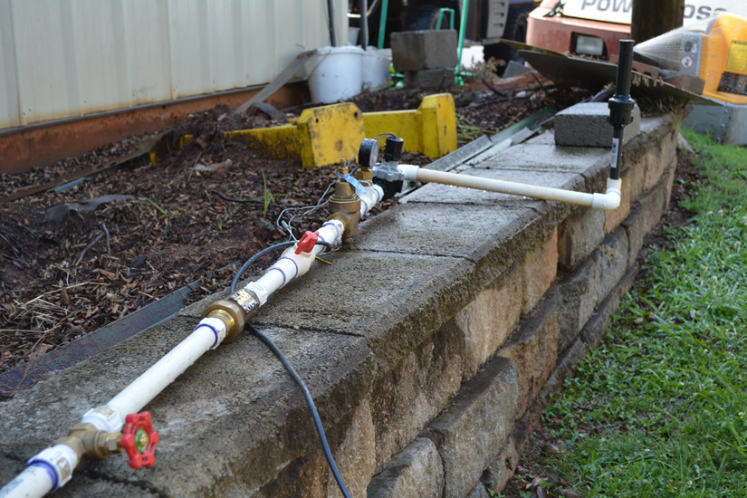
Photo by: G. Huber, UGA

Slide 78
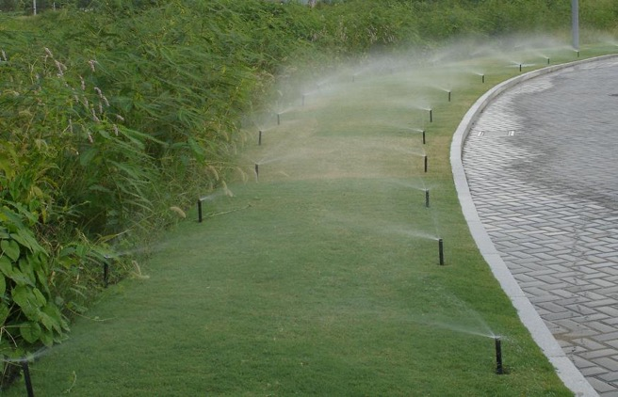
Make sure you set automatic sprinklers correctly and adjust it as conditions change.
Water early in the morning to reduce the evaporation rate.
If water runs off your yard, split your watering times into two or more sessions.
Be sure to turn off your system if you’re getting enough water from rain showers.
Photo by mraIrrigation

Slide 79
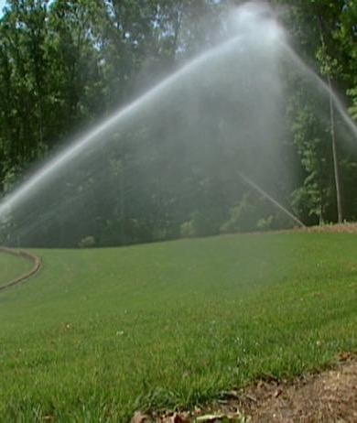
sprinkler bodies with integral pressure regulation can provide a constant flow at the sprinkler nozzle to help reduce water waste and provide more uniform distribution of water across the landscape.
Photo by DIY Network

Slide 80
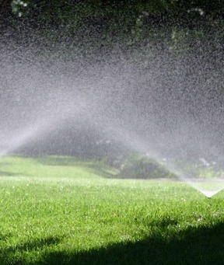
Pay attention to spacing between sprinklers during replacement to ensure the sprinklers have a matched precipitation rate, have matched trajectories, and offer head-to-head coverage.
Photo by lawn-care.co.nz

Slide 81
Test Your Knowledge
Using the training kit provided:
Identify all tools and irrigation parts
Assemble the appropriate components for a drip irrigation system.
Assemble the appropriate components for an overhead irrigation system.
Explain the pros and cons of drip and overhead irrigation methods

Slide 82
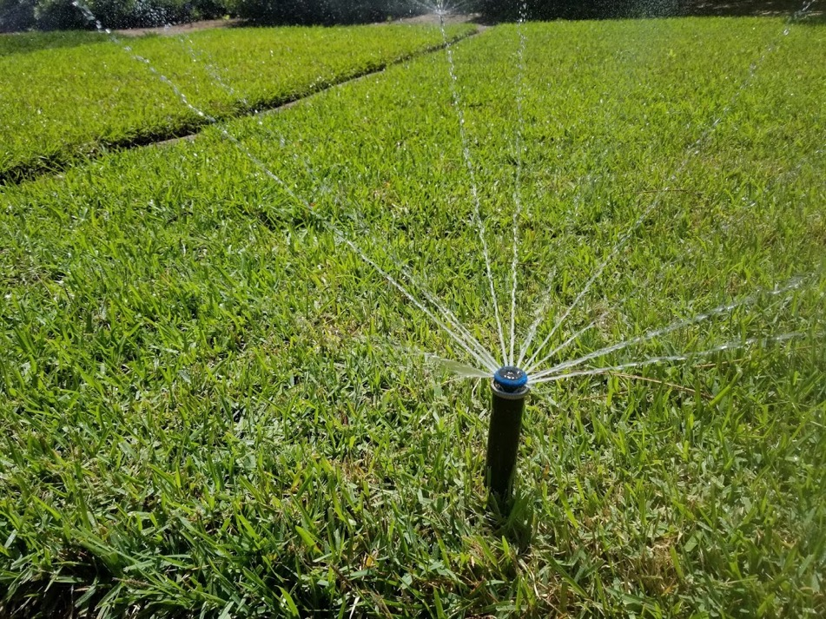
QUESTIONS ?

